Slide 1

UofL Research and Innovation: Website Redesign
Project Manager: Emily Wantland
Web Developers: Sohal Patel, Matthew Jackson
Database Admins: Scott Pettyjohn, Keegan Foulke
Systems Analyst: Nathan Moran
Team GOD
(Granter of Data)

Slide 2
Problem
Solution
Poor UX/UI
Redesign website
Too many clicks to reach content
100+ dead links
Stakeholder-oriented design
All dead links eliminated
3 clicks MAX to reach content

Slide 3
Stakeholders
Researcher
View content
Industry
View content
Student
View content
Create/edit/delete user profile
Create/edit/delete user profile
Event Reminders
Apply for grants
Create/edit/delete user profile
Event Reminders
Event Reminders
Create grants

Slide 4
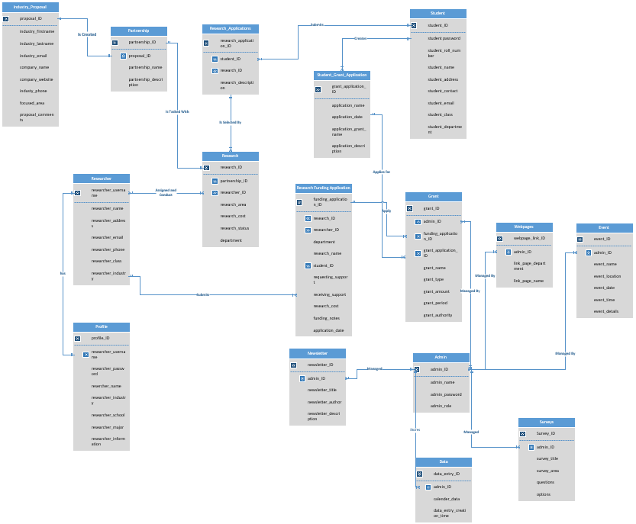
Full Schema

Slide 5
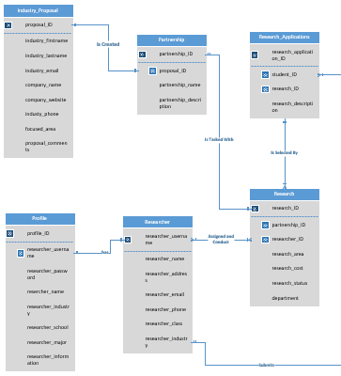
Sub-Schema: Research

Slide 6
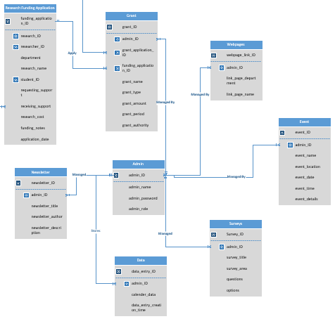
Sub-Schema: Admin

Slide 7
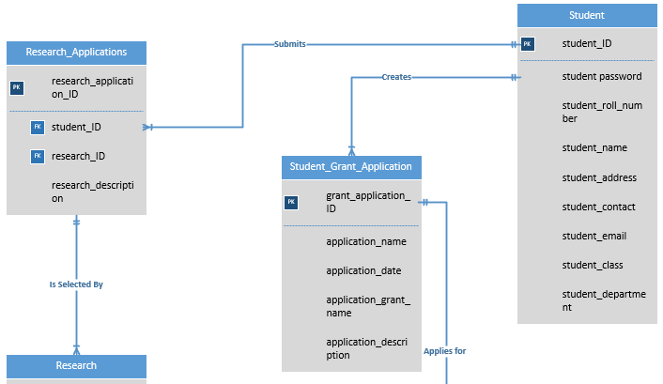
Sub-Schema: Student

Slide 8
Technologies and Tools
Project Management Software:
Asana
Wireframe Development:
Pencil
Development Platform:
Microsoft Visual Studio
Database Platform:
SQL Sever
Entity Relationship Diagram
Visio

Slide 9
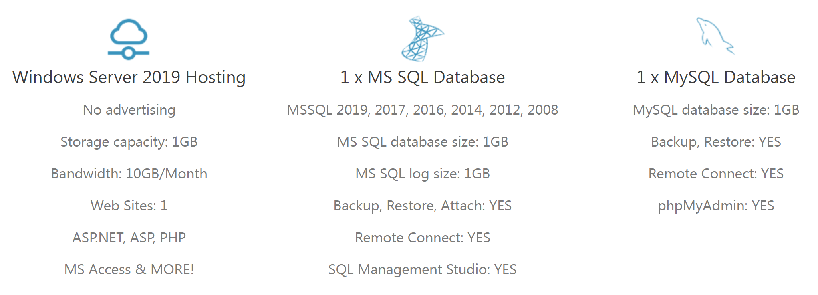
Hosting and Domain
SmarterASP.NET
.
Domain
www.ResearchAtUofL.com

Slide 10
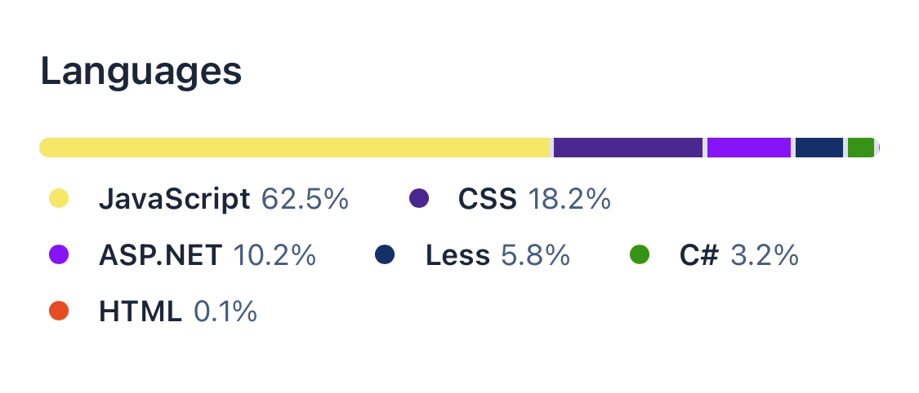

Languages Used
JavaScript – 47.4%
HTML5 – 24.4%
CSS3 – 11.2%
C# – 7.1%
ASP.NET – 6.8%
Less – 3.0%
PHP – 0.1%

Slide 11
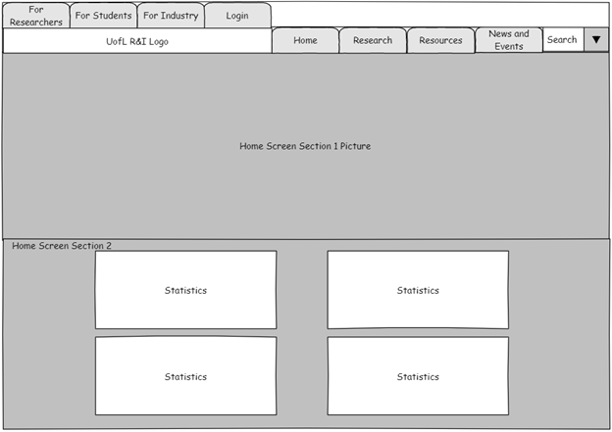
Wireframe
The landing page features 6 sections
Section 1 – Banner picture
Section 2 – Statistics and infographics

Slide 12
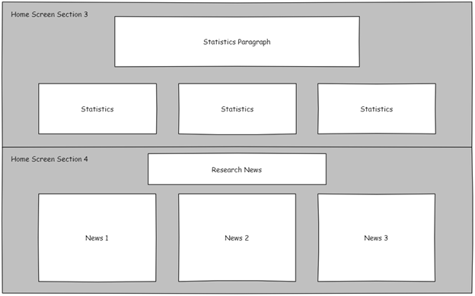
Wireframe
Section 3 – Statistics and infographics
Section 4 – Research specific news section

Slide 13
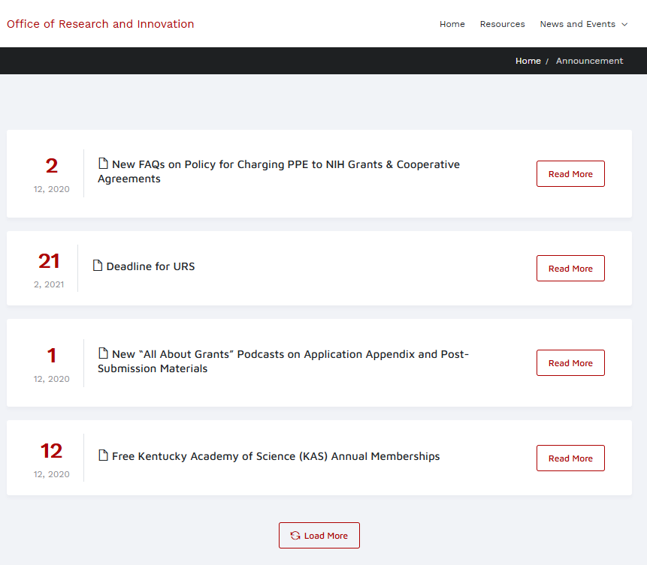
Announcements Page
Brings announcements to the view in a pleasing way
Modular design updated by date
Able to load more for looking into the future
Ordered by date

Slide 14
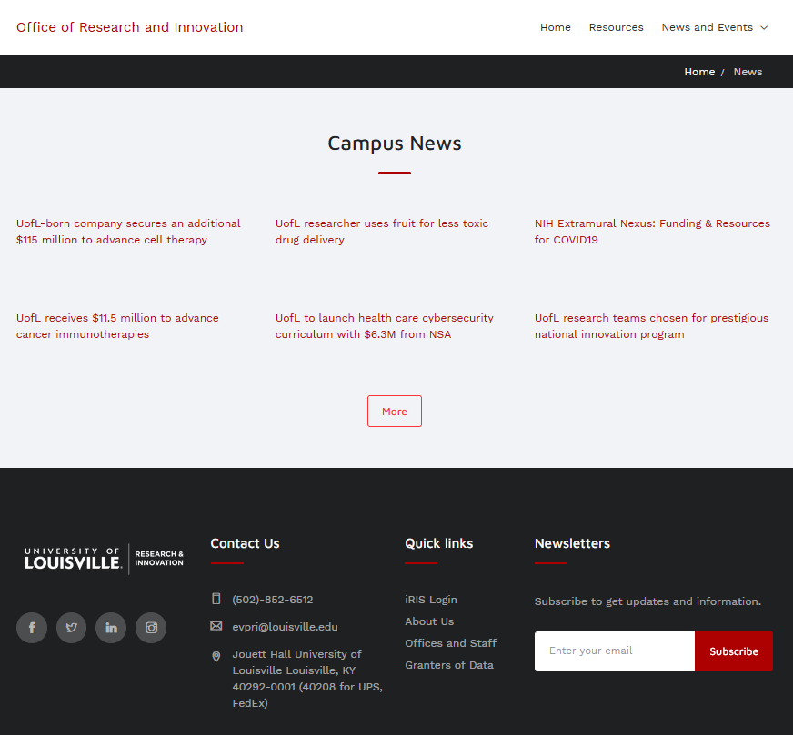
News Page
Like announcements page
Ordered by date
Grid style offers customization
Clickable to expand info

Slide 15
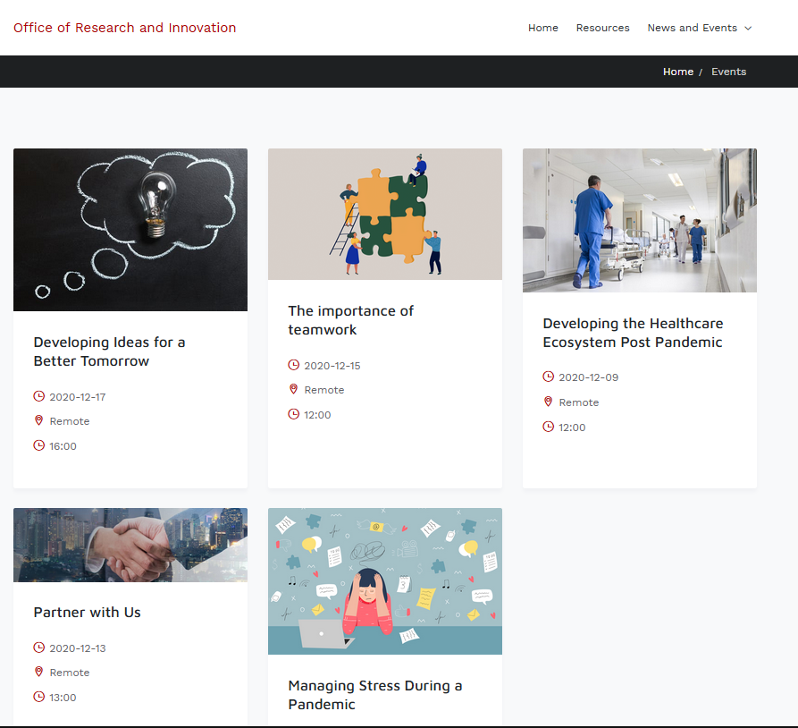
Events Page
Like previous two pages
Gives time and location
View Details gives more info
Grid style offers responsive design for multiple devices

Slide 16

Summary
Domain:
www.ResearchAtUofL.com
Hosted by:
SmarterASP.NET
Team GOD (Granter of Data)
Lead Developer:
sohal.patel@louisville.edu

Slide 17

Questions?

